Slide 1
Allotmenteers
COMPUTER ENGINEERING
cse 5001 Term project
Project by:
Nasibullah Qarizada – 1900004691
Hasibullah Samadi - 1800004671
Supervisor: Akhan Bulut
Assistant: Merve Gün

Slide 2

overview
Introduction
Structure
Controllers
Views
Model
Conclusion
References

Slide 3
Introduction
Project Statement
The aim of the project is to Reserve Medical Equipments for Laboratories.
It will provide online service to customers.
Administrators can Add/Update Medical Equipments.

Slide 4

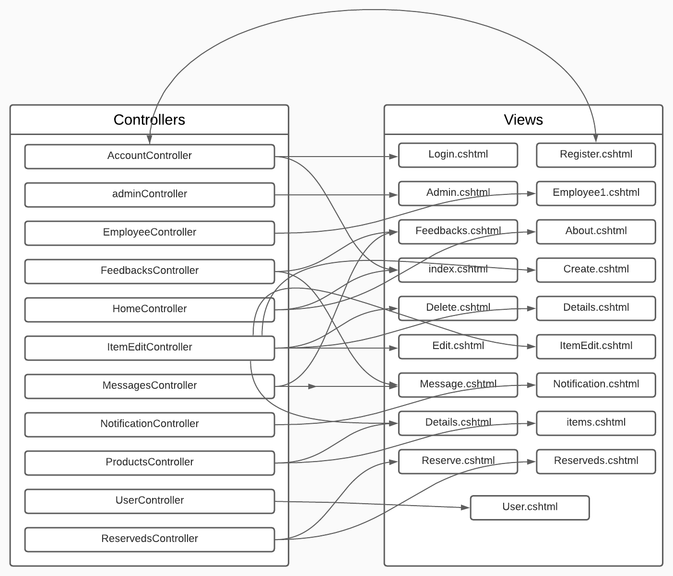
Structure

Slide 5
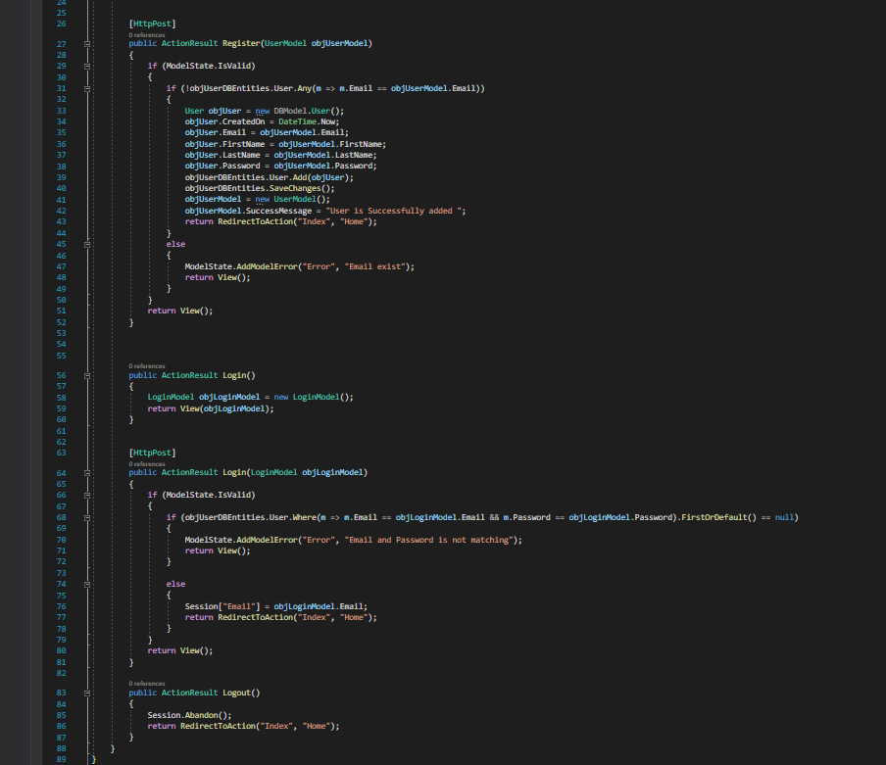
Register controllers
With the help of these controllers our users Can Login/Signup/logout to our Website

Slide 6
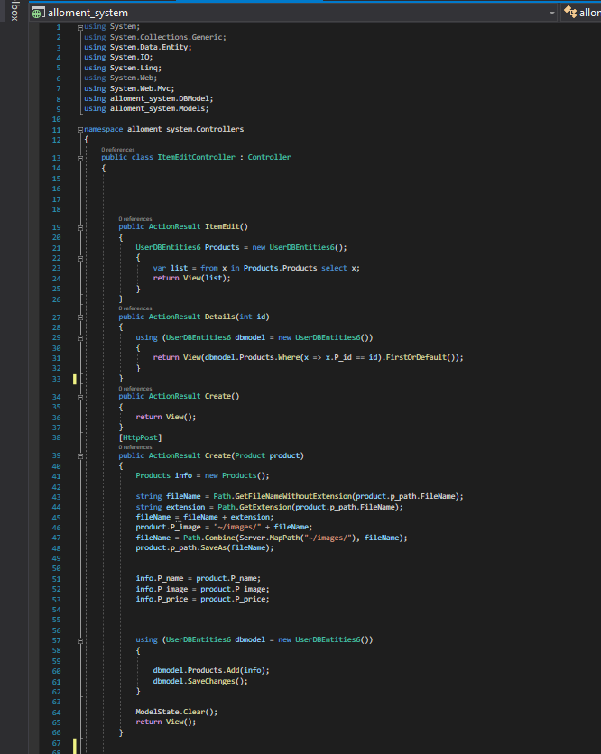
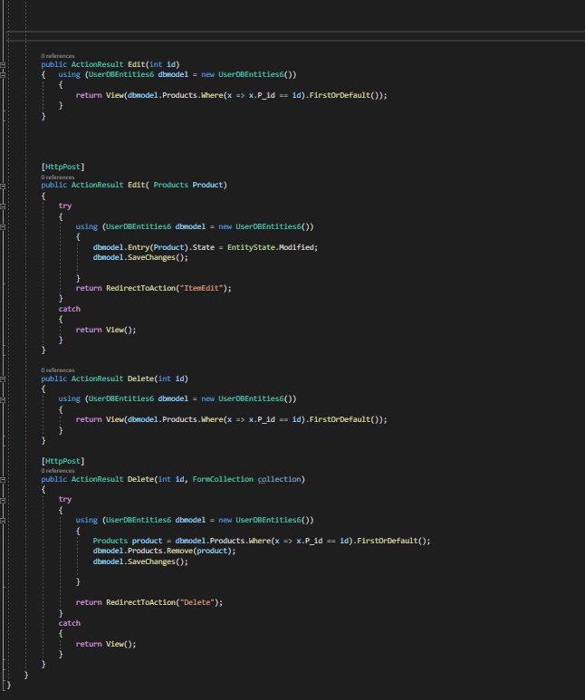
Item edit controllers
These Controllers Helps With:
List Product
Creating a New Product
Edit a Product
Delete A product

Slide 7
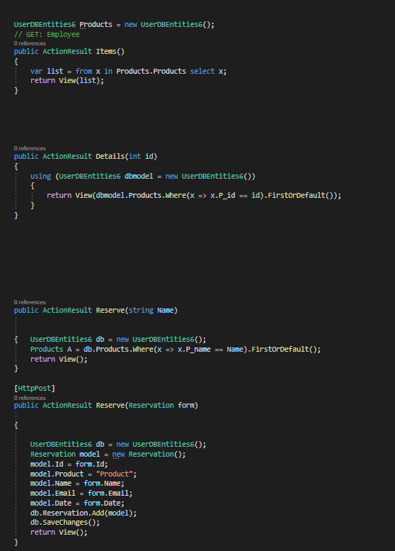
Item Reservation Controller
Lists the products for customer
Allows a Customer to reserve a product
Show details about the product

Slide 8
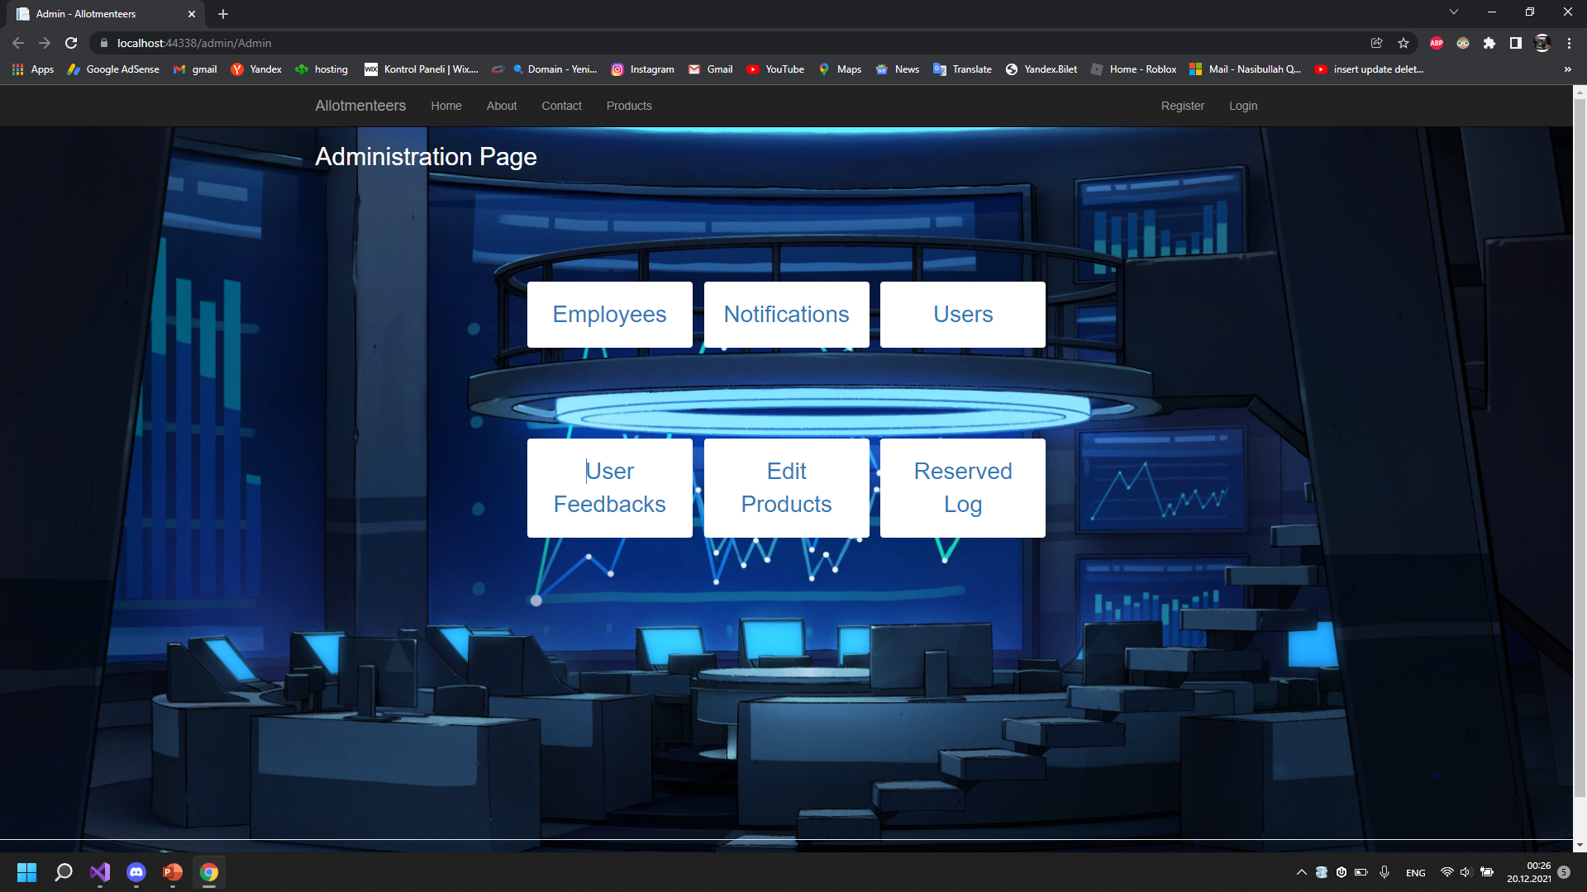
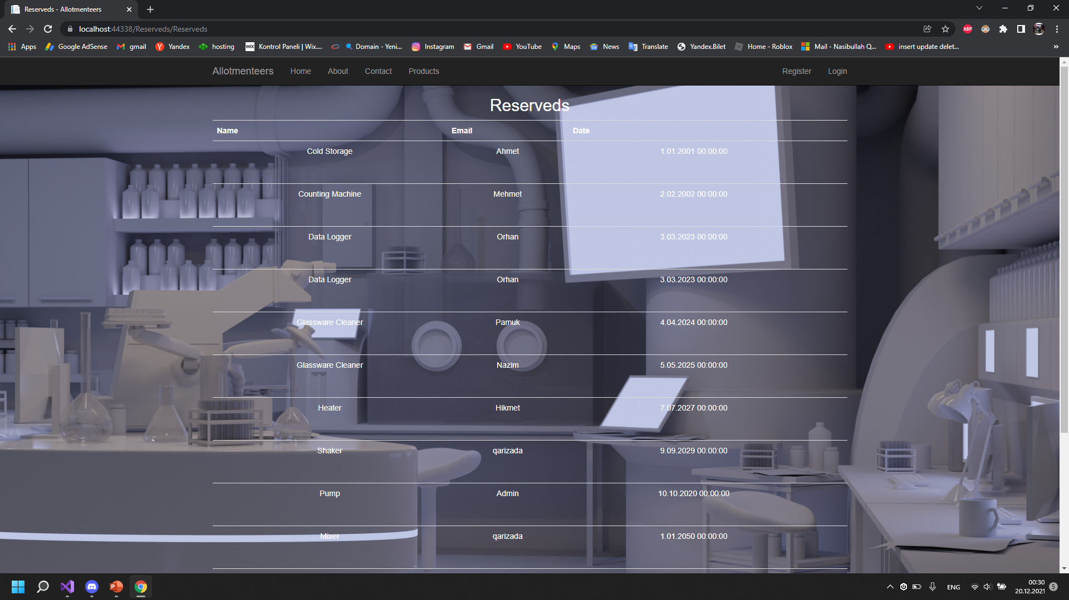
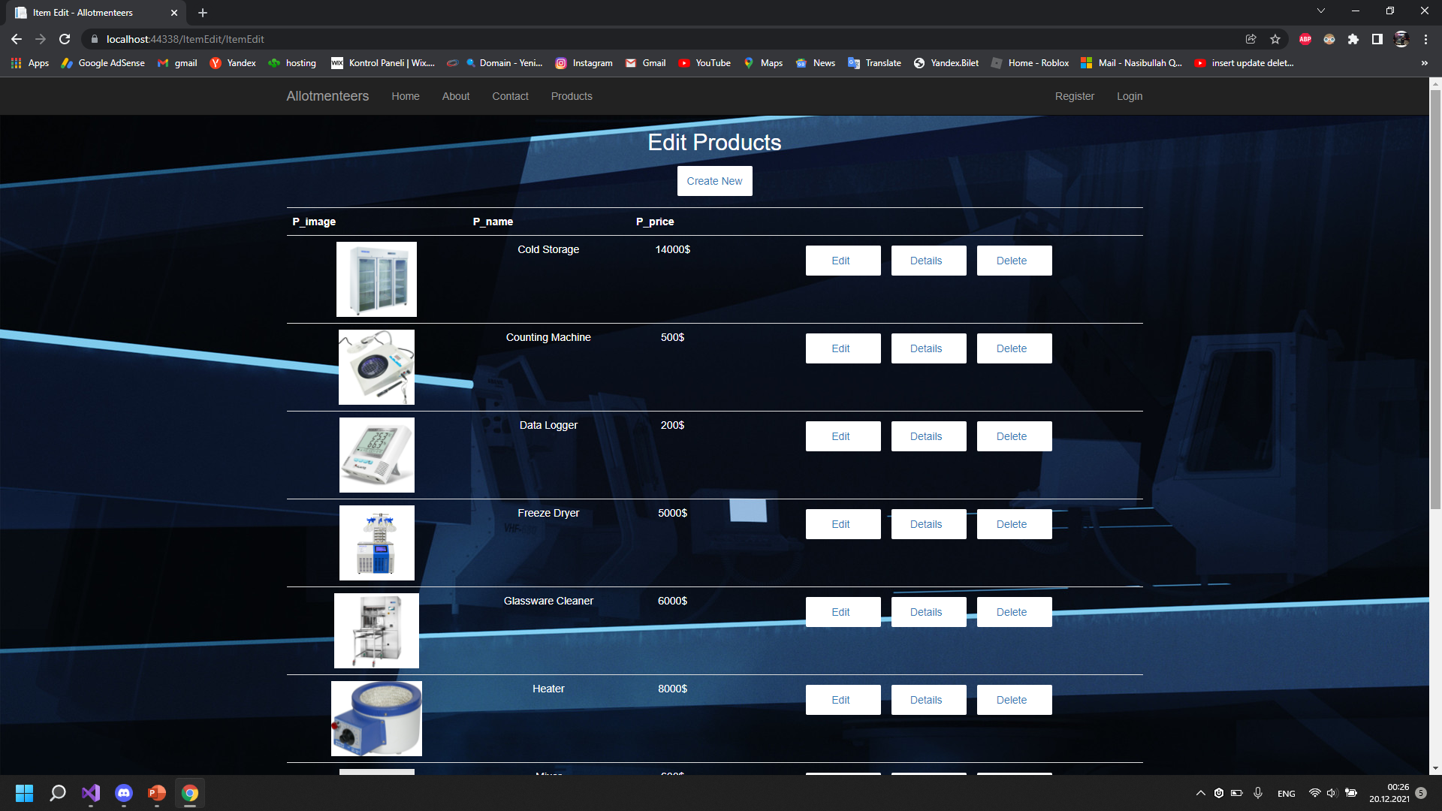
Admin views

Slide 9
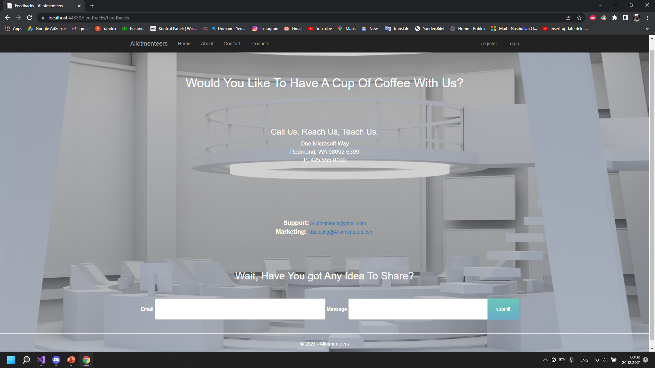
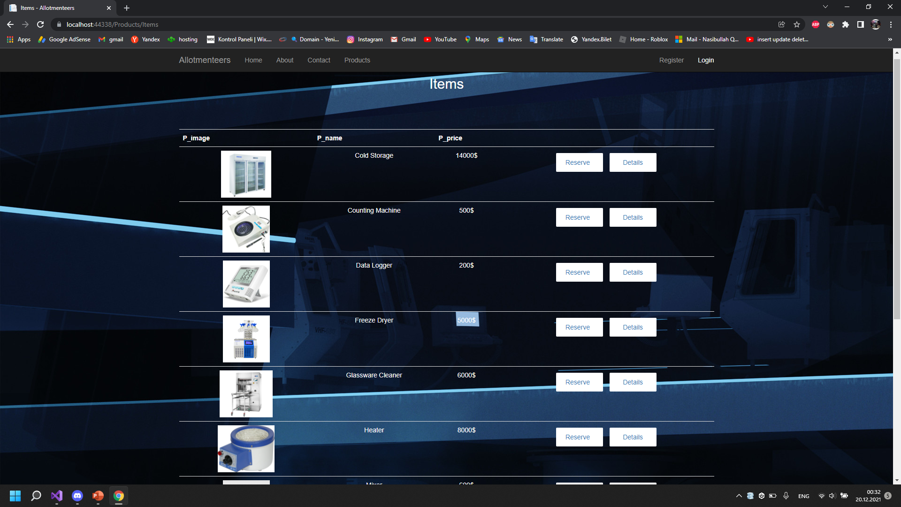
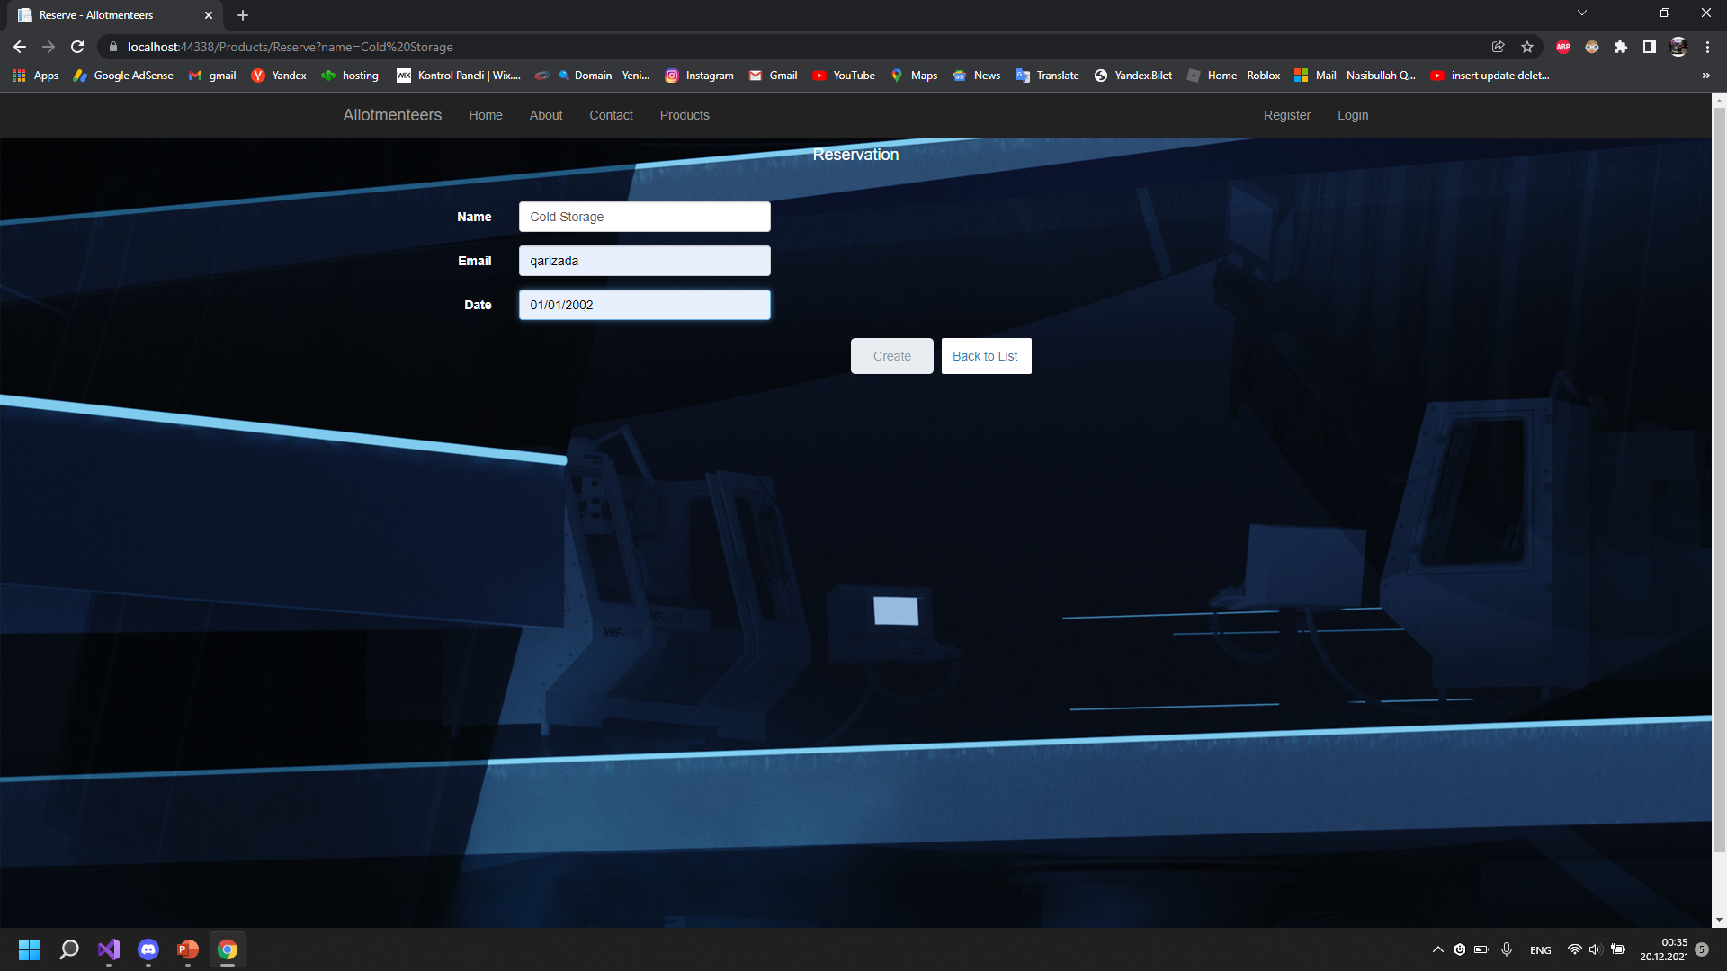
User view

Slide 10

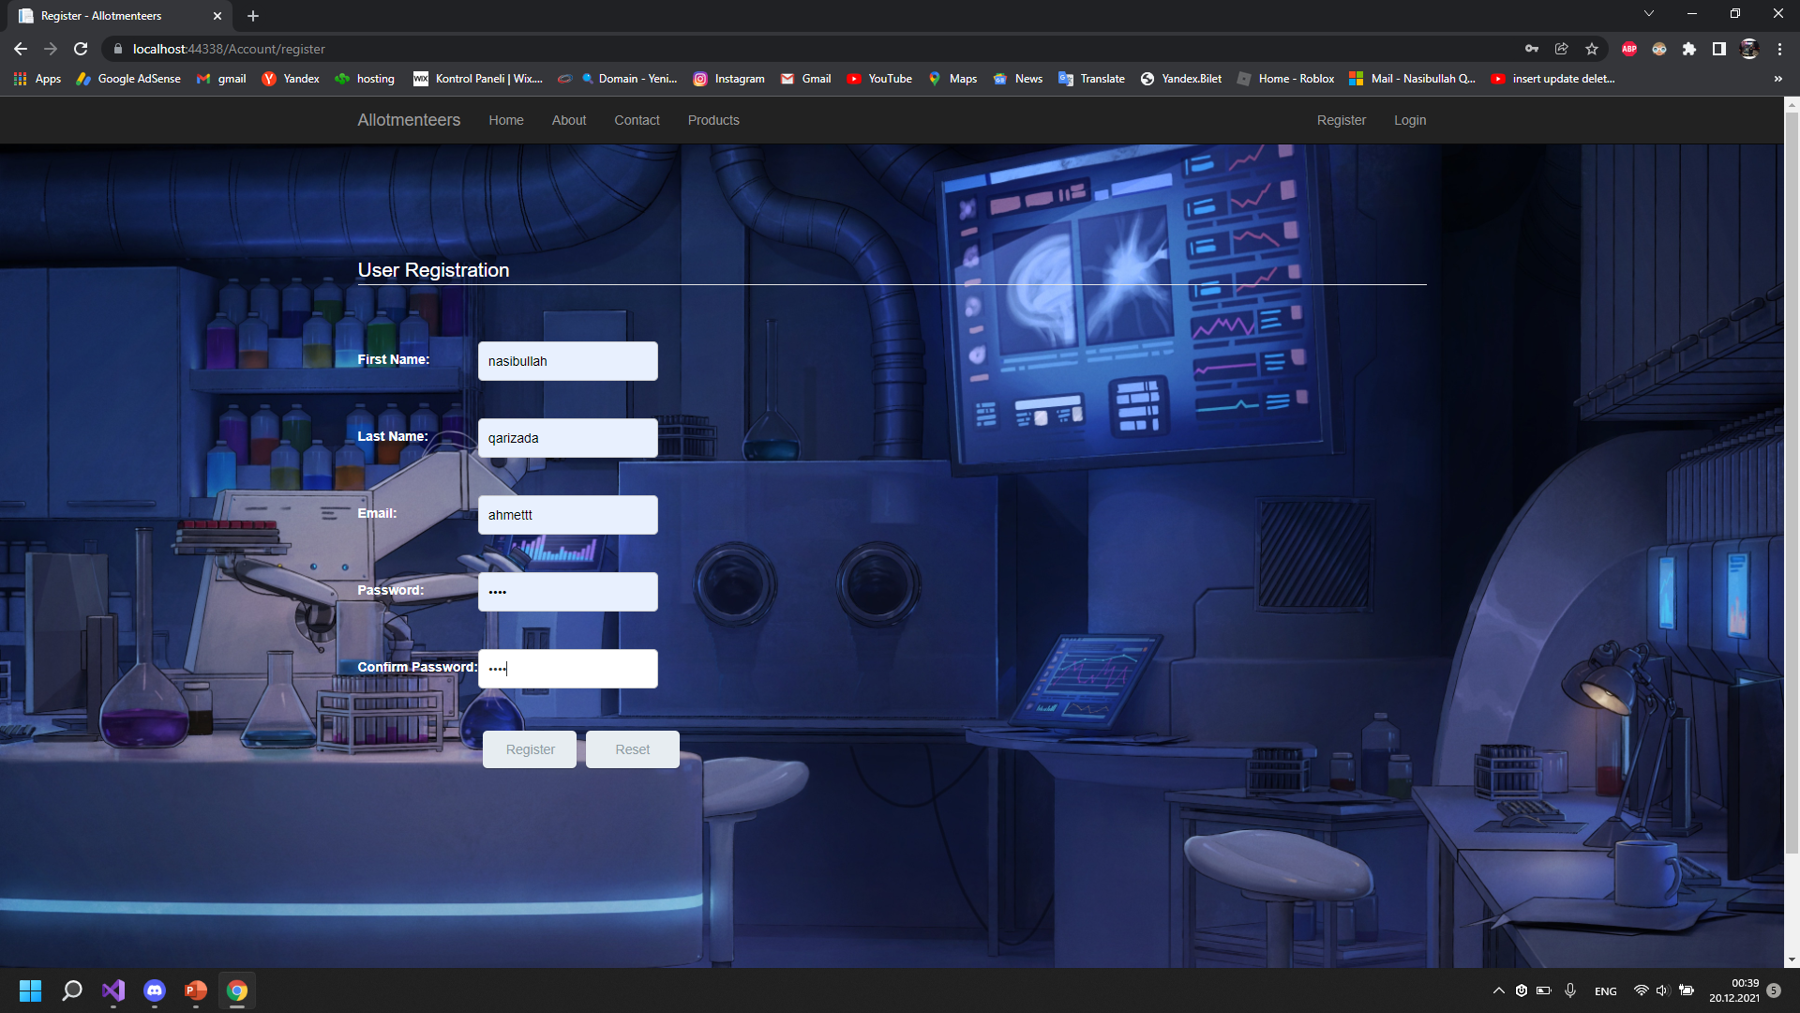
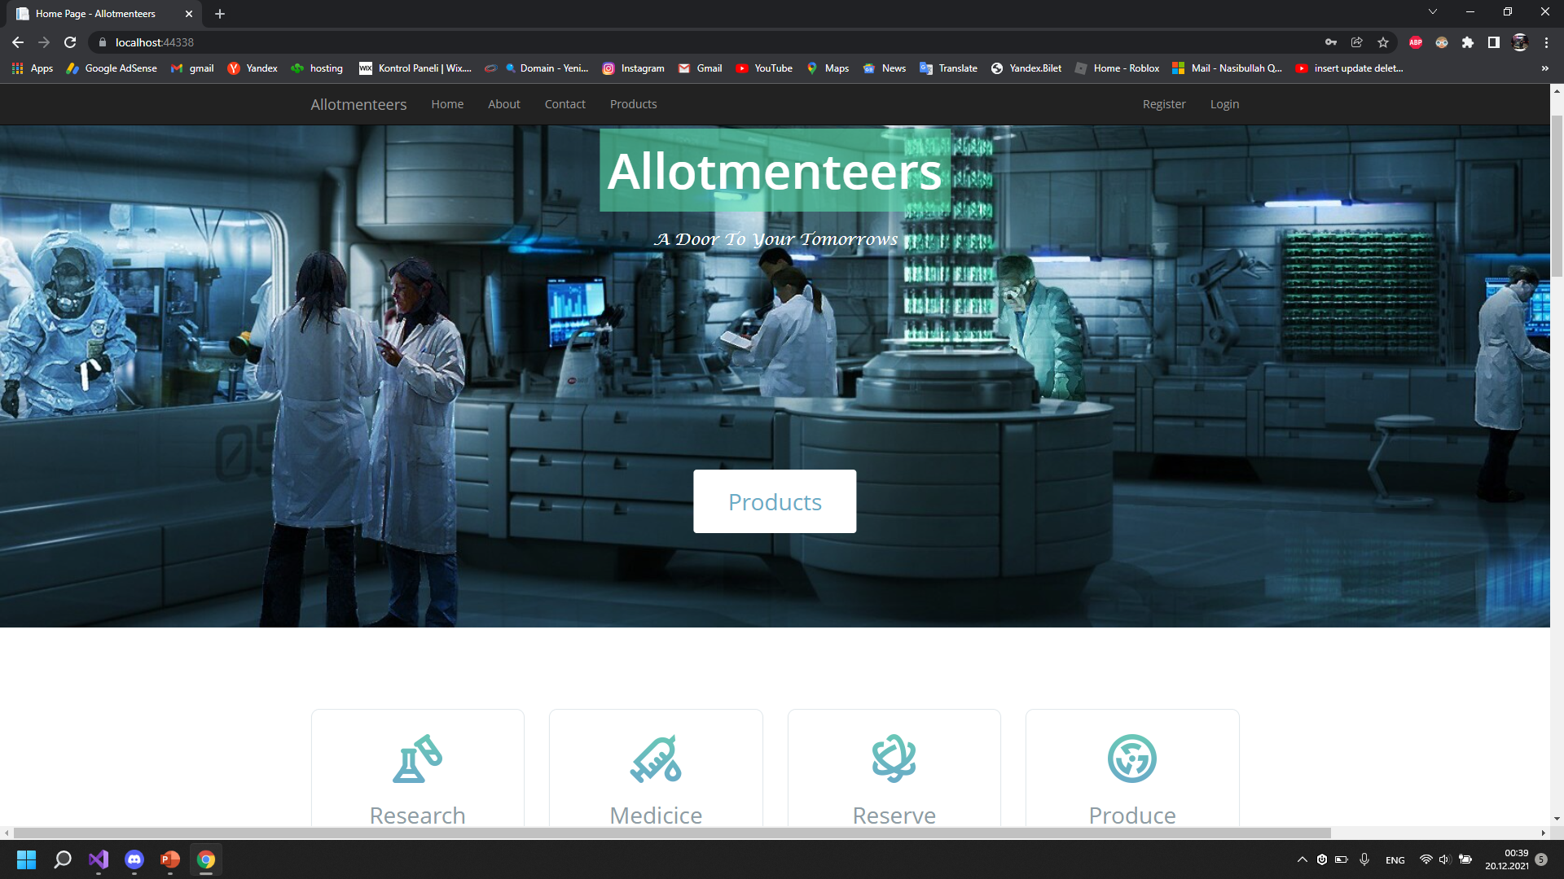
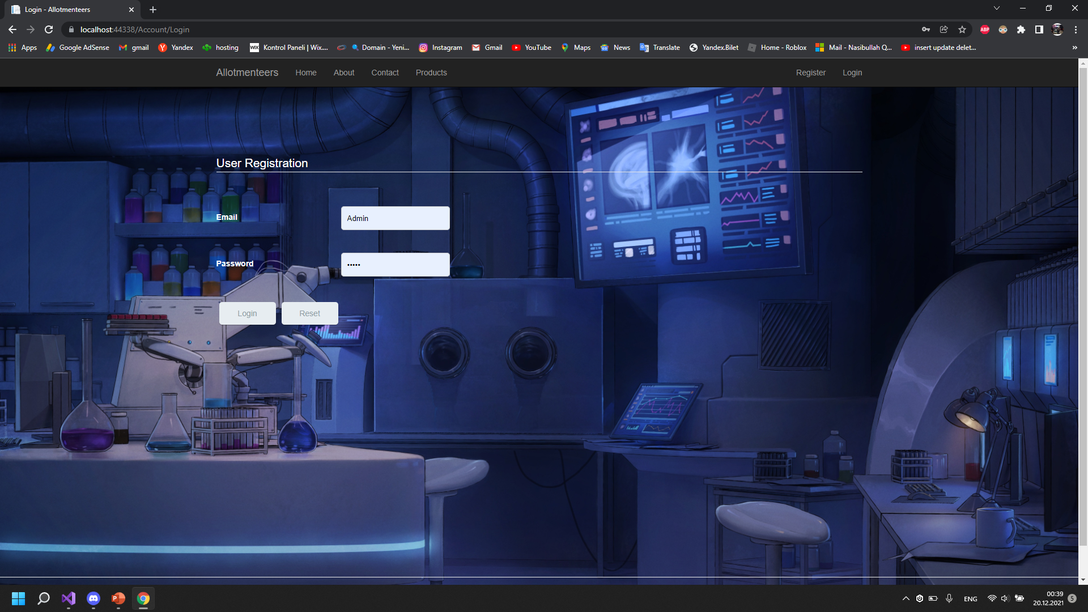
General interface

Slide 11
conclusion
Realizing the advantages of using MVC.
Learn how to create a Reserve System.
Understand how to interact with models and database.

Slide 12


REFERENCE
Wikipedia.org
Youtube.com
Lecture Materials
Github.com
W3schools.com
Stackoverflow.com

